Slide 1

Medical Insurance Cost Predictor
Data Science Project Final Review
05/11/2026
 | Under the Guidance of Dr. N. Sunanda Associate Professor, Department of Computer Science and Engineering, KLH CSE Bowrampet Campus
Team Members U. Jaya Sindhura- 2420030044 K. Ushasri -2420030376 P. Smitha-2420030583

Slide 2
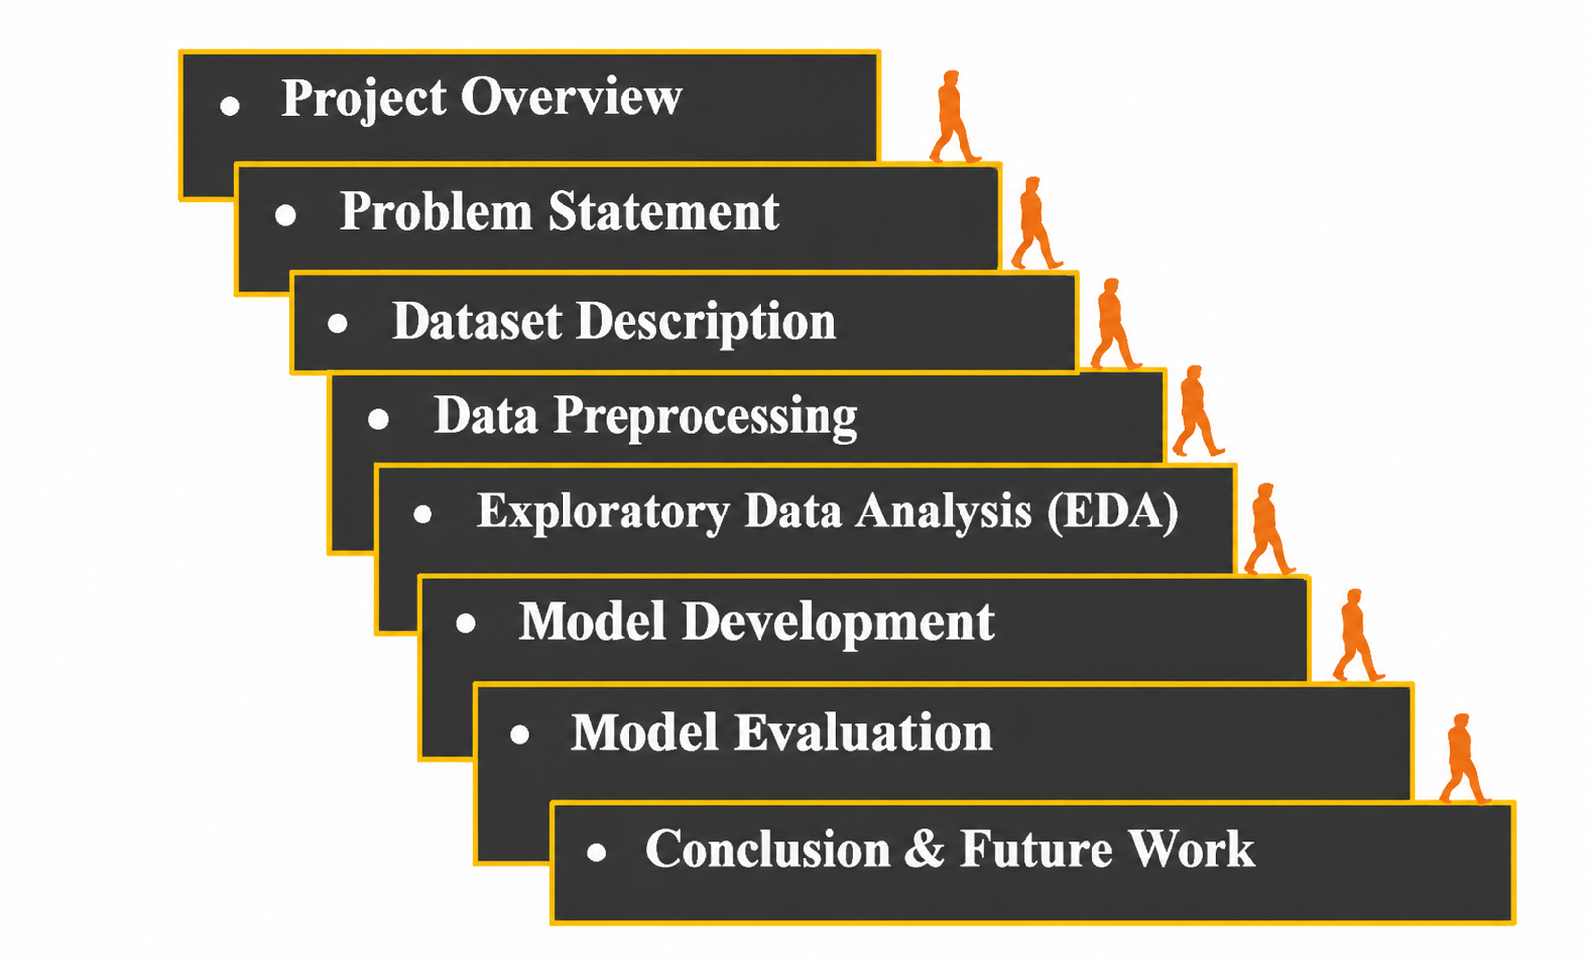
Outline of Project Work

Slide 3
Project Overview
Medical Insurance Cost Predictor is a machine learning-based project that combines insurance cost prediction with an interactive Streamlit dashboard.
Uses machine learning techniques to analyse medical insurance data and estimate insurance costs.
Explores Linear Regression and Random Forest Regression algorithms.
Collects user details and health information, including age, state, and city.
Provides disease matching and illustrative treatment cost estimation.
Offers insurance plan selection, balance tracking, claim management, and disease analytics.

Slide 4
Problem Statement
Medical insurance charges vary from person to person.
Insurance costs depend on factors such as age, BMI, smoking habits, and other personal details.
Manually estimating medical insurance costs can be difficult and time-consuming.
Traditional estimation methods may not capture complex relationships between these factors.
Machine learning techniques can help analyze insurance data and estimate medical insurance costs.

Slide 5
Dataset Description
Dataset: Medical Cost Personal Dataset
Total records: 20
Total attributes: 7
Features:
Age – Age of the individual
Sex – Gender
BMI – Body Mass Index
Children – Number of dependents
Region – Residential region
Charges – Medical insurance cost
Target Variable: charges

Slide 6
Exploratory Data Analysis (EDA)
Analysed the distribution of medical insurance charges.
Examined how age relates to medical insurance costs.
Studied the relationship between BMI and insurance charges.
Identified patterns and variations in the dataset.
Used data visualization techniques to understand the dataset before model training.

Slide 7
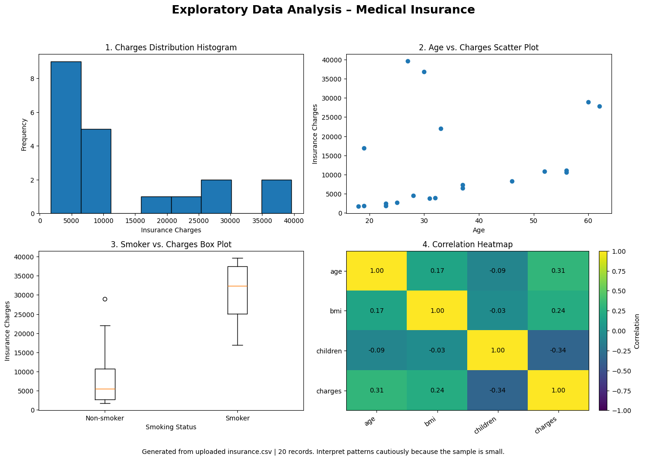
Exploratory Data Analysis (EDA)

Slide 8
Model Development
Algorithms Implemented
1. Linear Regression
Establishes a linear relationship between input features and insurance charges.
Used as a baseline regression model.
2. Random Forest
Uses multiple decision trees to predict insurance charges.
Combines predictions from multiple trees.
Captures non-linear relationships in the dataset.
3.Technologies Used
Python
Pandas and NumPy
Matplotlib and Seaborn
Scikit-learn

Slide 9
Model Evaluation
Evaluation Metrics
MAE: Measures the average absolute prediction error.
MSE: Measures the average squared prediction error.
RMSE: Measures prediction error in the target variable's units.
R² Score: Measures how well the model explains variations in insurance charges.

Slide 10
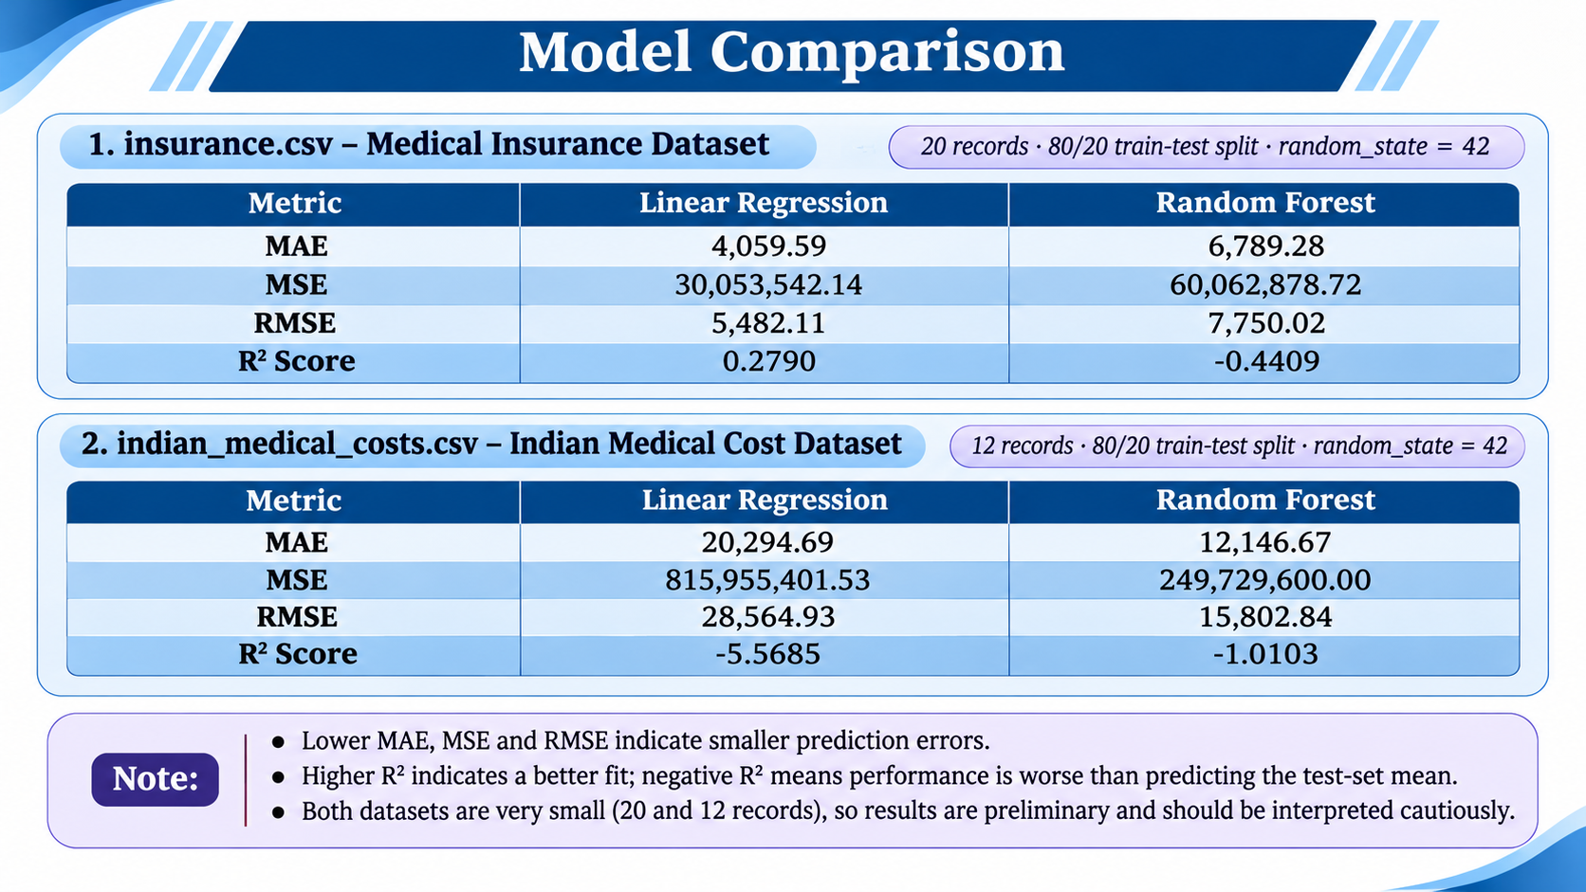
Model Evaluation

Slide 11
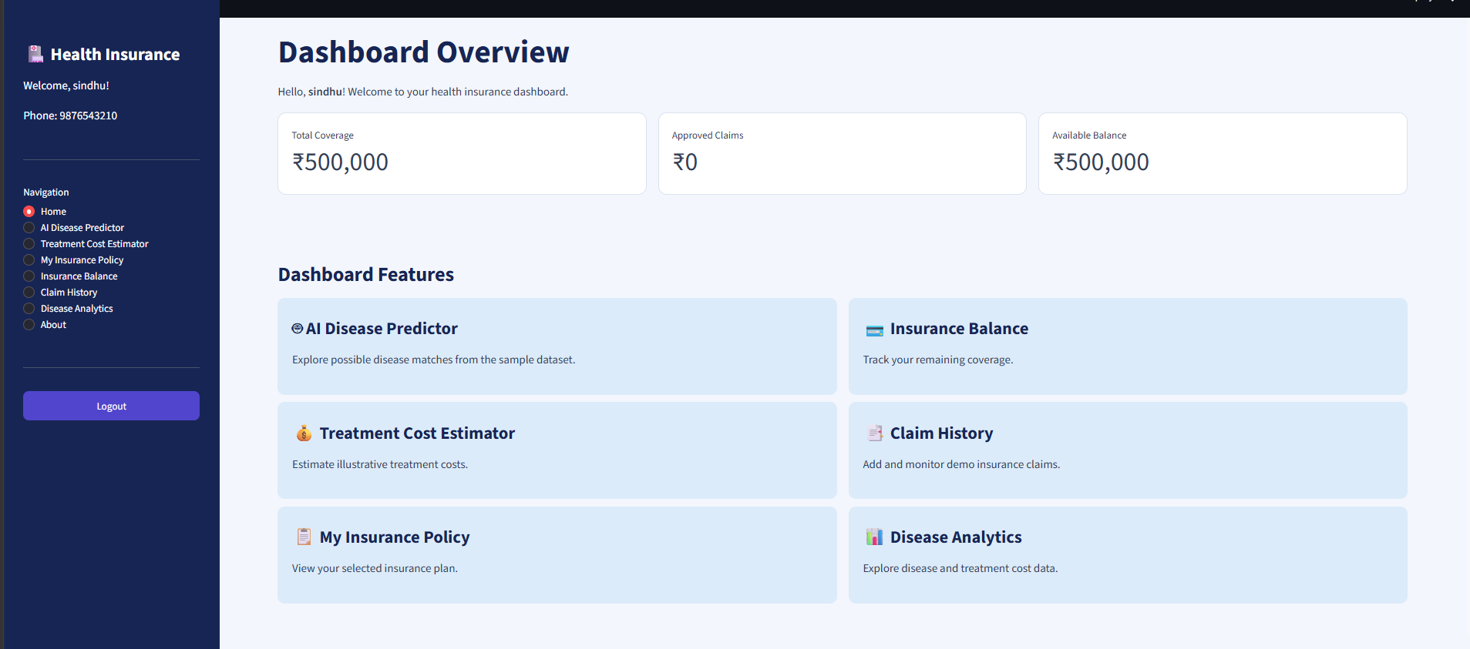
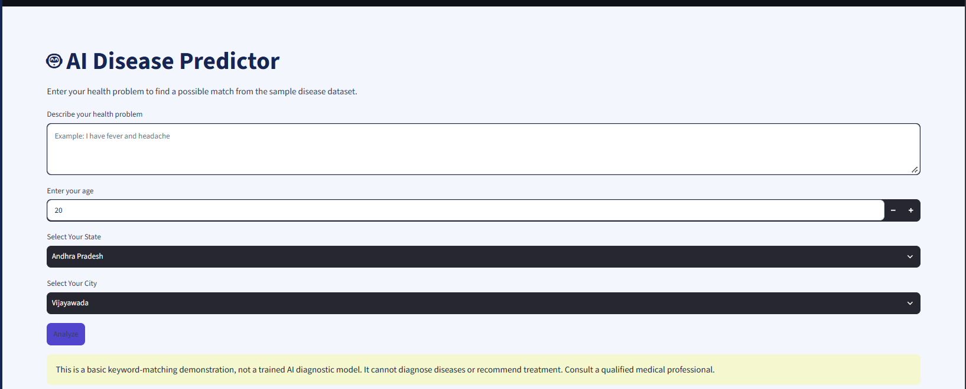
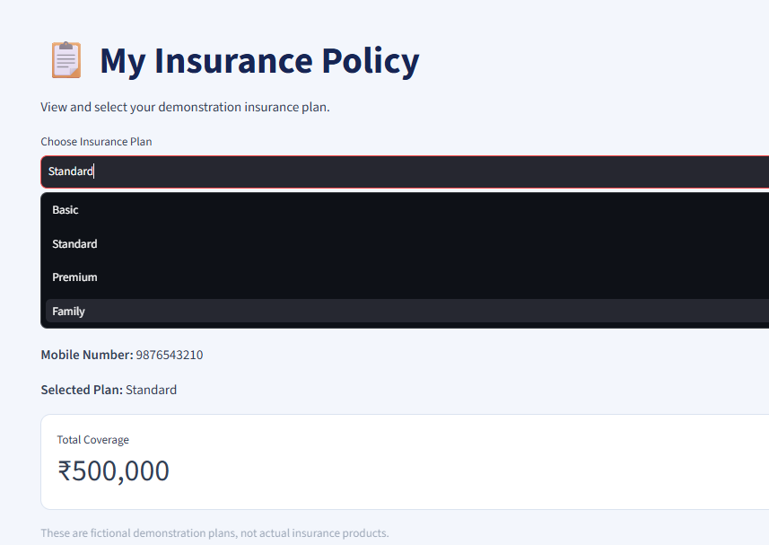
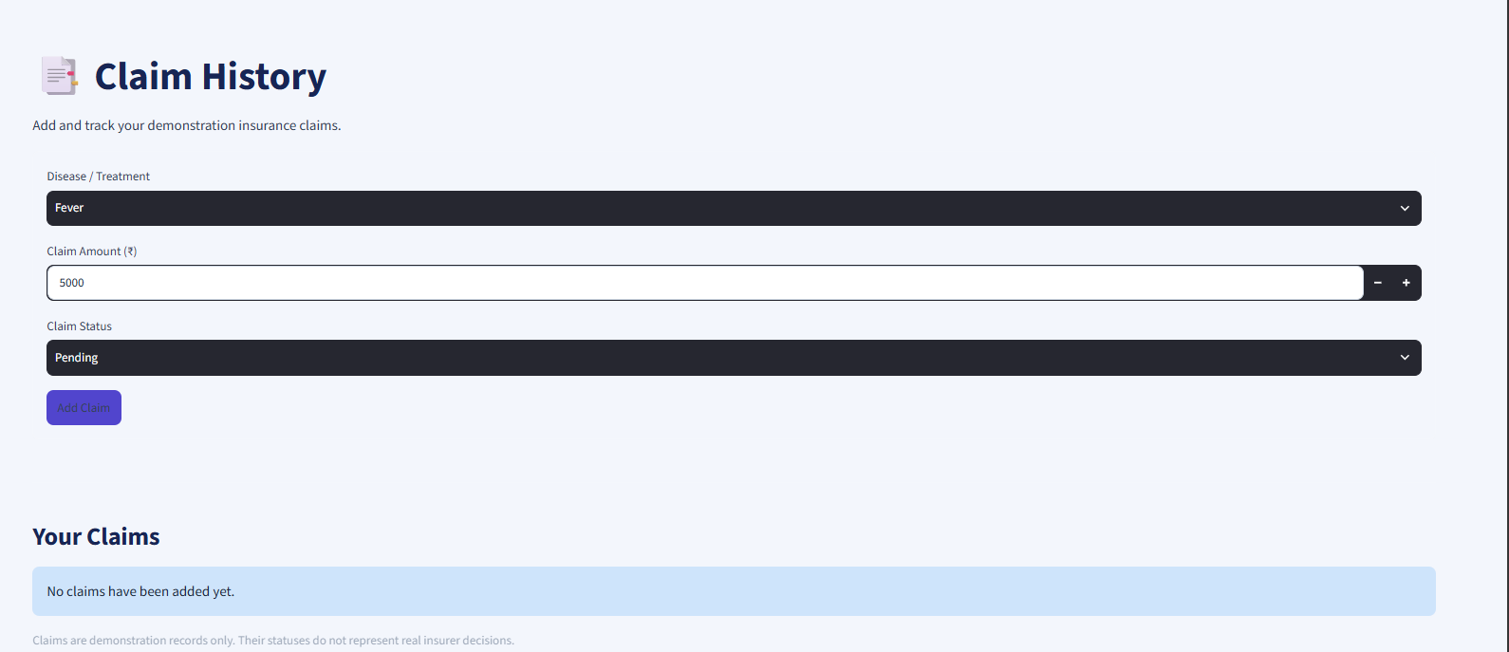
Results

Slide 12
Conclusion & Future Work
Conclusion
Developed a medical insurance cost prediction project using regression techniques.
Used personal and lifestyle-related features from the medical insurance dataset.
Implemented Linear Regression and Random Forest Regression.
Evaluated model performance using MAE, MSE, RMSE, and R² score.
Developed a Streamlit dashboard for disease matching, treatment cost estimation, and insurance management.

Slide 13
Conclusion & Future Work
Future Work
Integrate the trained regression models into the Streamlit dashboard.
Improve prediction performance using larger datasets.
Include verified Indian medical treatment cost data.
Add secure user authentication and permanent claim storage.
Enhance cost estimation with more relevant health-related features.

Slide 14
Thank you

